Slide 1

Approaches to Security Controls testing
Securing the Law Firm 2023

Slide 2
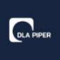




Agenda
Securing the Law Firm 2023
Approaches to Security Controls testing
The importance of validating security controls coverage & performance
How to reduce business risk through close control monitoring
Responding to incidents and lessons learnt
Introduction
Steve Davies
Head of Cybersecurity at DLA Piper UK LLP
linkedin.com/in/sldavies
about.me/stephendavies

Slide 3

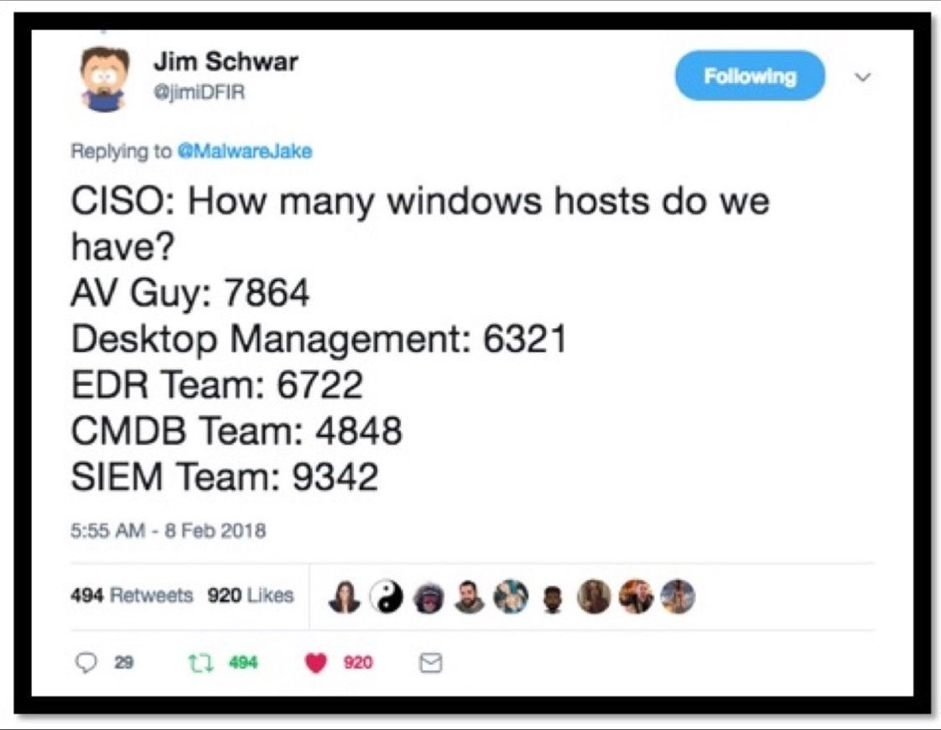
The Importance of validating security controls
Securing the Law Firm 2023
Problem: The ‘wait and see’ strategy isn’t a strategy
Many security teams still do not test their security controls
Controls coverage is often best efforts
Environmental complexity can undermine controls
Control configuration management can be difficult
Controls often fail silently
Control efficacy is usually TBC or wait and see
Notes:
Analogy with Home Alone / SecOps / Blue Team and Home alone – we set traps, formulate a then wait to see if it works on the night
IT is hard. The basics are hard. IT Teams spend a lot of time patching / hardening and we do some checks (vuln scanning etc) but again … we wait to see if it works on the night
We can’t accept that things might change / break AND also sleep at night, thinking we have done everything we can to prepare for cyber incidents

Slide 4
The Problem
Securing the Law Firm 2023
Operating at Risk
“Security controls are composed of people, processes, and technologies, and absent regular testing against real-world threats, there is no way to ensure they will perform as intended when the time comes”
If we don’t test…
coverage and continuity, we might not have controls to detect/disrupt our adversaries
all environments (on-prem, cloud), we might not have the right controls
configuration, our controls might not work as expected OR deceive us
efficacy, we won’t know for sure that our controls will hold up against specific threats
Notes:
So we’re all operating at risk
If we don’t test our controls, we won’t know how exposed we might be to real world threats
If we don’t test our controls, we wont know what the impact might be should our controls fail to a real world threat

Slide 5
The Solution
Securing the Law Firm 2023
Cybersecurity Readiness Testing
Given the importance of cybersecurity controls and investment in cybersecurity resources it is vitally important that security teams endeavour to validate their cybersecurity readiness
Ways to test Cybersecurity Readiness;
Manual Processes – outline manual checks, reports, alerts and tests
Set testing objectives – leverage testing activities *or* commission testing
Automated Testing – employ breach attack simulation tool to automate testing
Tabletop Exercises – employ scenario driven role-play exercises
Notes:
The solution for not knowing, not testing then is simple – we need to test, we need to know
There are things we can already do to fill this gap
There is now an industry dedicated to addressing this risk and I’m going to introduce you to that today

Slide 6

Testing with Manual Processes
Securing the Law Firm 2023
Implement manual checks (turn-key reports, dashboards, email digests etc)
Implement manual tests (BAU atomic tests)
Strengths
Weaknesses
Can provide useful insight into coverage and licensing issues
Can provide high-level insight into version/configuration consistency
Can provide a some degree of confidence around efficacy via release notes, update digests etc
Can be the starting point for threat informed defence thinking…
Likely to get de-prioritised in favour of ‘real work’ and become ad-hoc
Unlikely to test controls holistically or provide scientific results around coverage or effectiveness
Unlikely to scale well
github.com/redcanaryco/atomic-red-team
Notes:
Manual checks and processes are better than nothing
It’s difficult to use them to achieve anything more than a high-level understanding around whether your controls are deployed and doing *something*
There is an interesting and useful counter-point to Manual Checks which make sure things are working…
We can deliberately break our controls to see if we notice … chaos engineering
Simply stopping /crashing out an agent here and there can be a starting point. This should also validate your service monitoring ;)
I’ve had some ‘fun’ writing custom network signatures for benign events (think dns lookup for google.com) and then using them to see if logging works and/or people notice and investigate.

Slide 7

Setting Testing Objectives
Securing the Law Firm 2023
Set specific control testing objectives during security testing engagements
Objectives might include testing control efficacy Vs adversary techniques
Strengths
Weaknesses
Can provide great insight into control coverage and effectiveness against real-world adversary TTPs
Can provide very specific insight into controls effectiveness in relation to critical services and assets
Can be the starting point for joint red + blue team operations, aka purple teaming
Allows organisations to map controls against new technologies and services
Expensive and infrequent
Expensive to scale
Mileage may vary
OWASP A09:2021
Logging and monitoring can be challenging to test, often involving interviews or asking if attacks were detected during a penetration test. There isn't much CVE/CVSS data for this category, but detecting and responding to breaches is critical. Still, it can be very impactful for accountability, visibility, incident alerting, and forensics.
Notes:
** I have a real problem when people tell me they had a test and got no results … not even a general nod to whether the testing activity was detected **
You *should* be planning tests in a way that lets you test controls and processes – this is not new
You need to talk to testers before, during and after an engagement and I have a real problem with testing companies that want to limit dialogue and even charge to explore findings
A ‘quick win’ is to stop telling teams about tests and seeking forgiveness over permission. Testing what you can without knowledge should provoke a real-world response to a perceived real attack OR suspicious activity.
I highly recommend full red-team engagements with assumed breach as a starting point and with goals to defeat any/all controls. We’ve done 2 with no-notice (Adversary simulation) and found/fixed a lot of issues.

Slide 8
Automated Testing (Breach Attack Simulation)
Securing the Law Firm 2023
Continuously test your cybersecurity programme with automated controls testing
Embed purple team thinking and surface security control issues in real-time
Strengths
Weaknesses
Automated, holistic testing of controls across technology stacks and mappings
Provides real-time insight into control efficacy and coverage Vs real-world threats and TTPs
Drive red + blue team operations, aka purple teaming and the move to a threat-informed defence
Address the risks from untested security controls and unvalidated security posture
Measure and exercise cybersecurity maturity – technology, processes and people
Potentially expensive

Slide 9
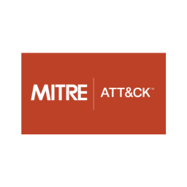
Automated Testing (Breach Attack Simulation)
Securing the Law Firm 2023
BAS Service
Results
Security Team
Test Plan
Tests
Integrations
Logs / Events
Test Candidates / Representative Sample
Security Technology Stack
SIEM

Slide 10
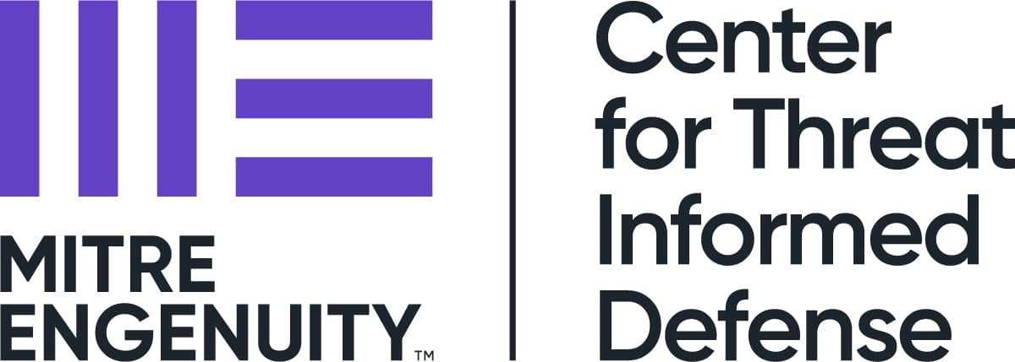

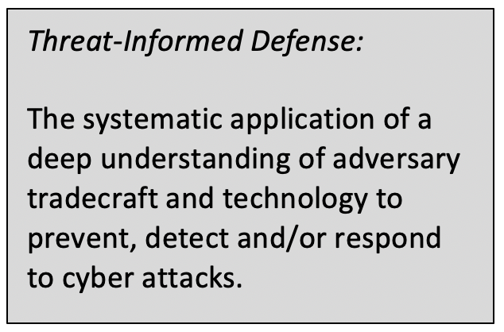
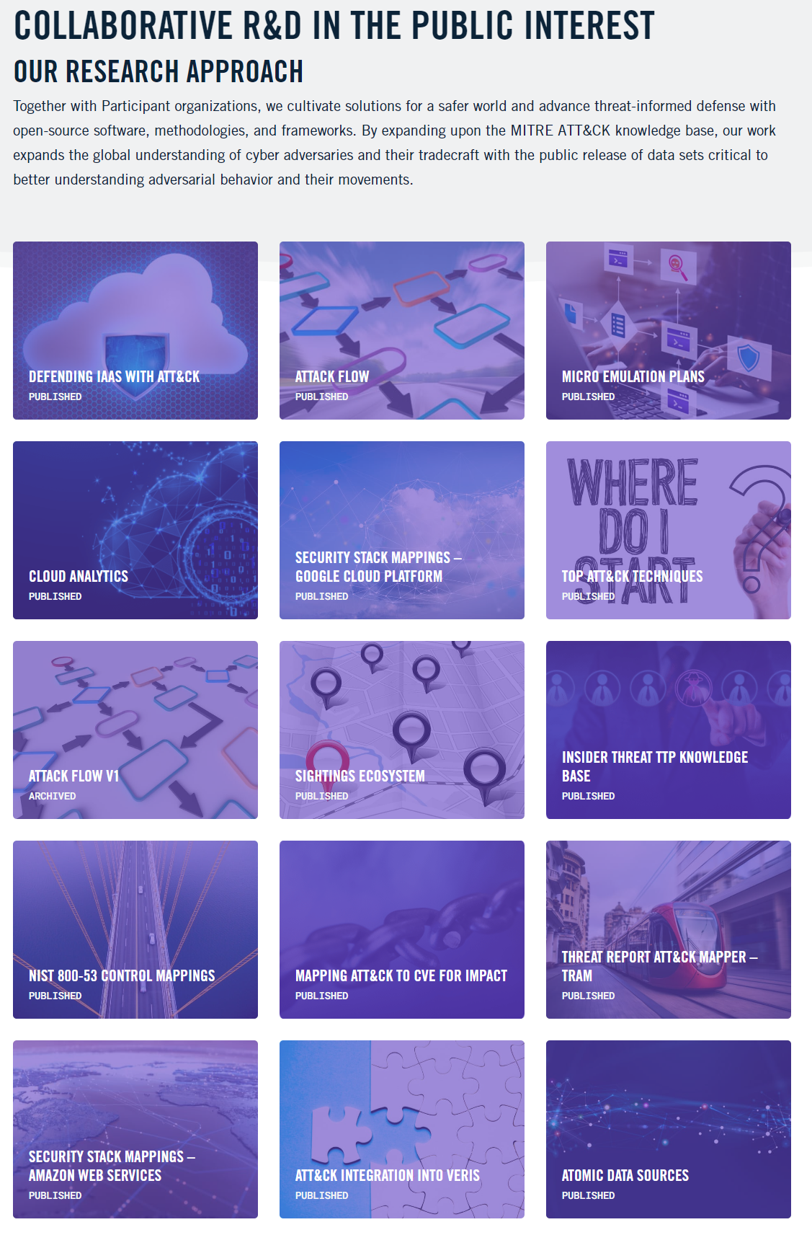
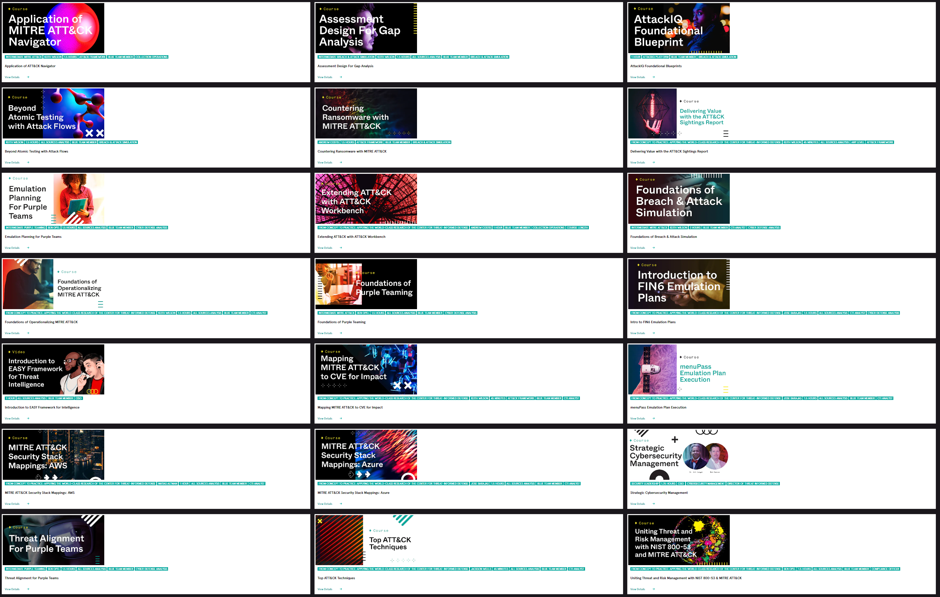
Automated Testing (Breach Attack Simulation)
Securing the Law Firm 2023
ctid.mitre-engenuity.org
www.academy.attackiq.com

Slide 11
Testing with Tabletop Exercises (TTXs)
Securing the Law Firm 2023
Test your cybersecurity programme with role-play tabletops
Deliver these internally or with assistance
Strengths
Weaknesses
Still useful!
Low cost (time, planning)
Fast (especially lightning scenarios)
Scale well with formal organisation
Dovetail with risk / controls assurance
No immediate technical validation
Mileage may vary
Notes:
#TabletopTuesday

Slide 12
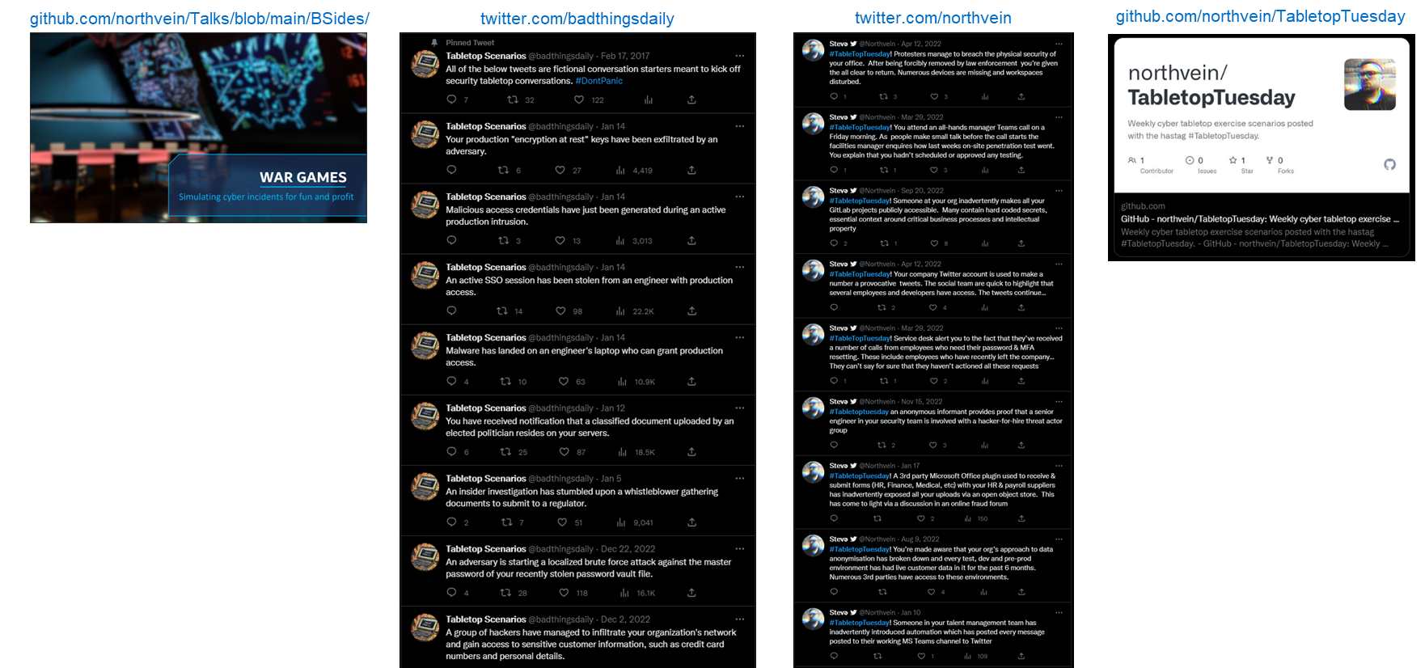
Testing with Tabletop Exercises (TTXs)
Securing the Law Firm 2023

Slide 13
Thank you

